Slide 1

APPLIED STATISTICS PROJECT
PULI DINESH – AI23BTECH11019
RATHOD SAI DHANUSH – AI23BTECH11021
JATAVATH AJAY – AI23BTECH11011

Slide 2
PROJECT 1
FOR THIS PROJECT WE HAVE TAKEN THE DATA AS MATCH SCORE OF VIRAT KOHLI IN IPL FROM
(2020-2024)
DESCRIPTIVE SUMMARY:
MEAN OF THE DATA : 33.76
MEDIAN OF THE DATA : 29
STANDARD DEVIATION : 28.64
VARIANCE : 820.29
RANGE :(0,113)
Q1(First Quartile):8.5 ; Q3(Third Quartile):50.5 ; IQR(Interquartile Range):42.0

Slide 3
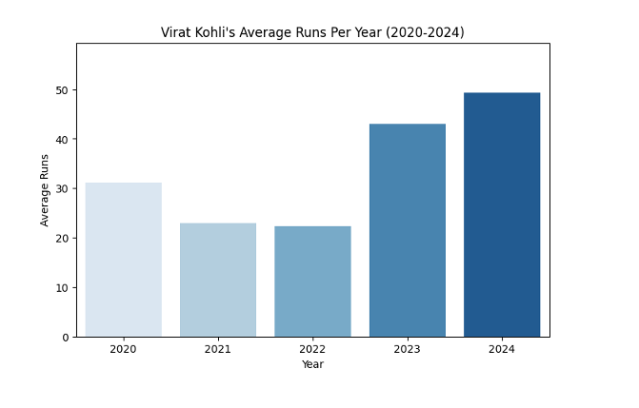
BAR DIAGRAM
The graph shows Virat Kohli’s Average runs from year 2020-2024
There is a rise in Virat Kohli’s average runs from 2020 to 2024.
His Performance was very low in year 2022 and high in year 2024
A dip is observed in 2021 and 2022, followed by an increase in 2023 and 2024.
Its a performance improvement after a decline.

Slide 4
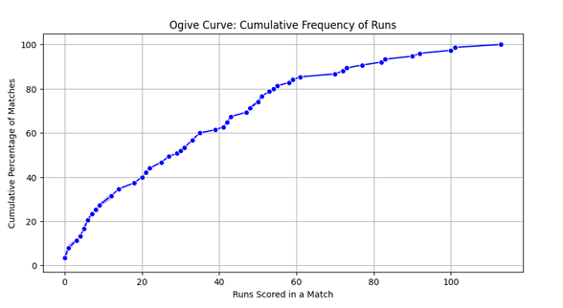
OGIVE CURVE
The graph shows cumulative frequency of runs of Kohli from year 2020-2024
From the graph, we can say that a majority of the scores are under 50.
The steep rise in the lower score range suggests most scores are concentrated there.
The curve flattens out at higher values, showing fewer large scores.

Slide 5
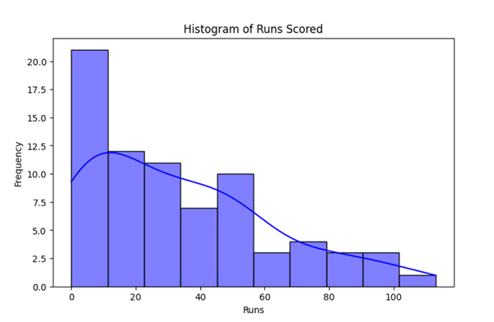
HISTOGRAM
The Histogram shows runs vs frequency of Virat from year 2020-2024
The histogram is Right skewed
The highest frequency is in the 0–10 run range
Runs above 60 are relatively rare
Long Tail Towards Higher Scores (like big scores exist, but they are not typical)

Slide 6
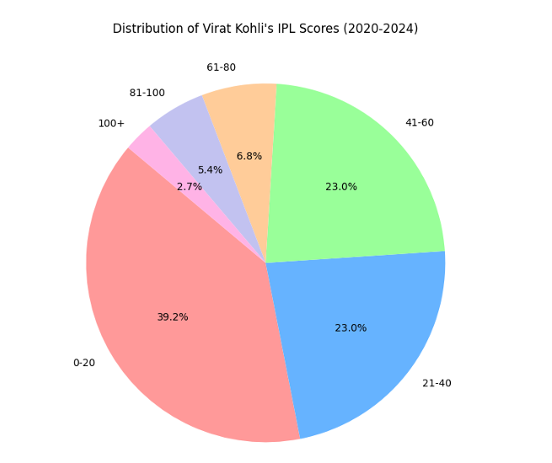
PIE CHART
The pie chart show distribution of kohli’s runs from 2020-2024
Most scores fall in the 0-20 and 21-40 range
Fewer innings with scores above 80
Indicates consistent scoring but fewer exceptionally high innings.

Slide 7
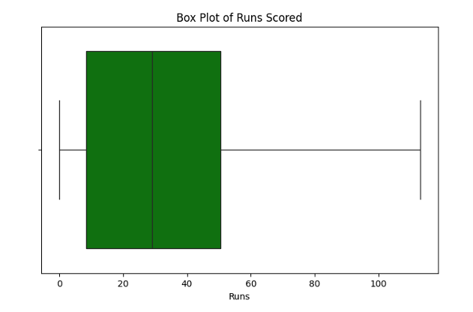
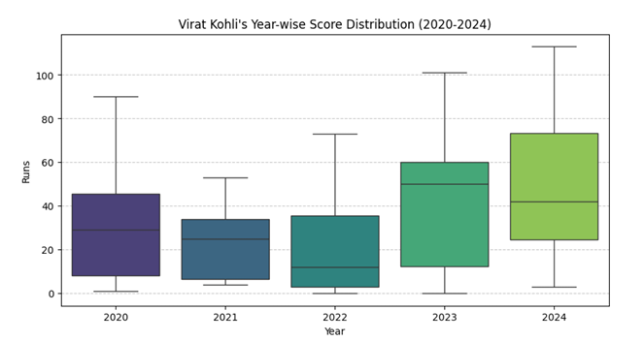
BOX PLOT
The Two Box Plots show year wise and overall performance of Kohli.
The spread of runs is wide, with some matches showing high scores.
Median is relatively low, which suggests it is a skewed distribution.
2023 and 2024 have wider interquartile ranges, indicating greater variation in scores
Median scores have increased in recent years.
Upper whiskers show more high-scoring matches in 2023-24.

Slide 8
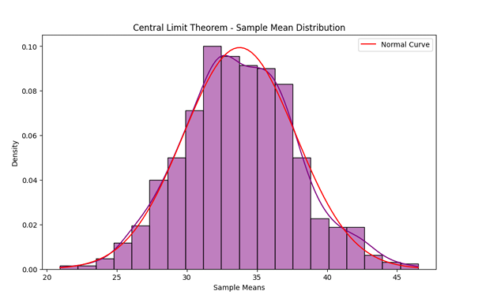
Central Limit Theorem
Histogram shows sample means from Virat Kohli’s IPL scores (2020–2024).
Despite variability in the original scores, the distribution of sample means is: Symmetrical and Bell-shaped
The red curve represents the ideal normal distribution, closely matching the histogram
CLT allows us to use normal distribution-based statistical techniques even when the original data (like match scores) is not normally distributed.

Slide 9
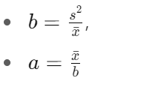
PROJECT 2
For this project , we have taken the Dataset as Global Sales from Video Game Sales Data
Gamma Distribution – Estimation of Parameters
Method of Moments (MoM):
Estimates:
Shape a=2.1766 ; Scale b=6.7504
Based on sample mean and variance
Maximum Likelihood Estimation (MLE):
Estimates:
Shape a=3.9330 ; Scale b=3.7359
Fitted using gamma.fit() with loc=0
Conclusion:
Data is positive and right-skewed, making gamma as suitable choice.
MLE is more accurate than MoM as it uses the full data likelihood.
Gamma distribution provides a good statistical fit

Slide 10
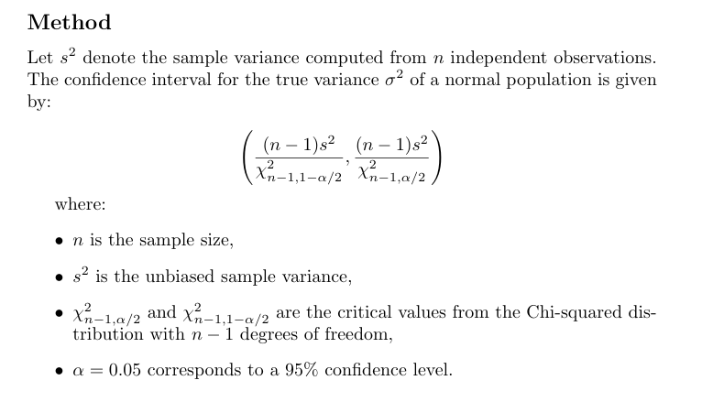
95% Confidence Interval for Variance
We are Estimating Variance of Global Sales (Assuming Normal Distribution)
After the calculation we get:
95% Confidence Interval (76.37,134.07)
We can conclude that 95% confident that the true variance of global sales lies within ($76.37m,$134.07m)

Slide 11
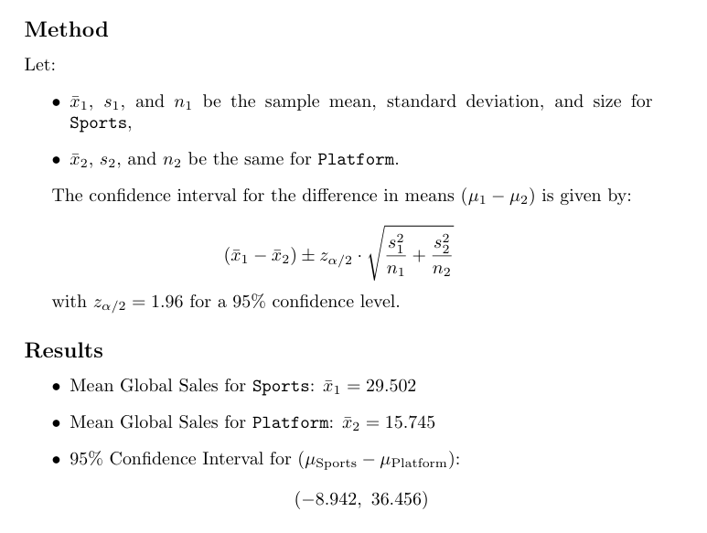
Confidence Interval for Mean Difference (Non-overlapping Genres)
Genres Compared: Sports vs Platform
Conclusion:
The interval includes 0 → no significant difference at 95% confidence level.
Cannot conclude that Sports sells more than Platform on average.

Slide 12
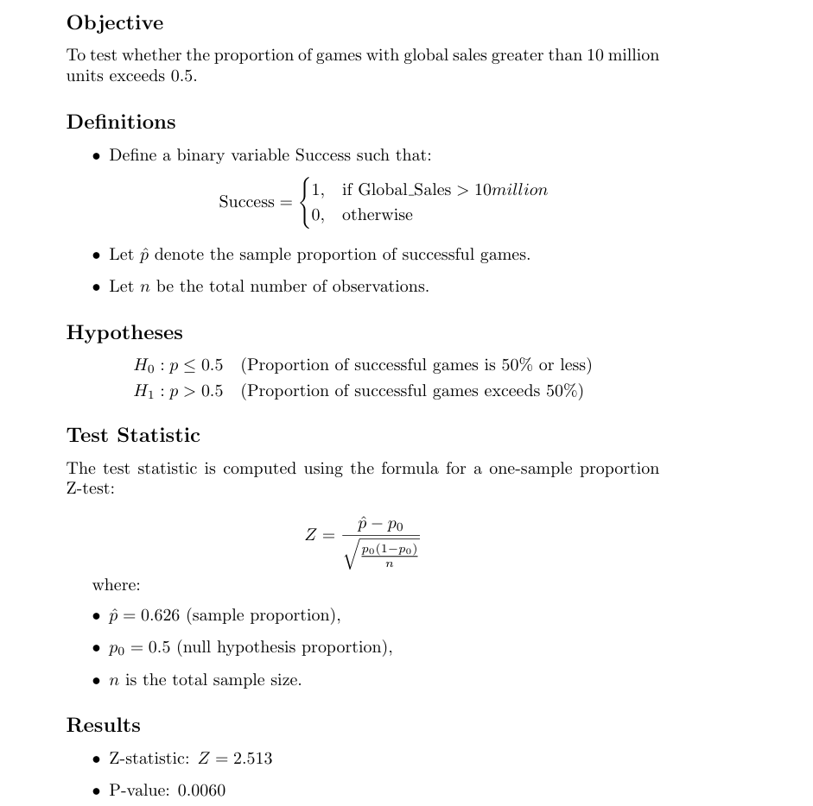
Proportion of High-Selling Games – Hypothesis Testing
Conclusion:
Since p-value < 0.05, reject H₀
Statistically significant evidence that more than 50% of games are high sellers i.e(global sales >$10m)

Slide 13
Thank you

